Slide 1
ASYMPTOTIC NOTATION

Slide 2
Text Book
Text Books
Introduction to Algorithms (Third edition) Cormen, Leiserson, Rivest, and Stein
An excellent reference you should own
Data Structures and Algorithms in C++ Goodrich, Tamassia, and Mount

Slide 3
What is a Data Structure?
Data is a collection of facts, such as values, numbers, words, measurements, or observations.
Structure means a set of rules that holds the data together.
A data structure is a particular way of storing and organizing data in a computer so that it can be used efficiently.
Different kinds of data structures are suited to different kinds of applications, and some are highly specialized to specific tasks.
Data structures provide a means to manage huge amount of data efficiently.
Usually, efficient data structures are a key to designing efficient algorithms.
Data structures can be nested.

Slide 4
Types of Data Structure
Data structures are classified as either
Linear (e.g, arrays, linked lists), or
Nonlinear (e.g, trees, graphs, etc.)
A data structure is said to be linear if it satisfies the following four conditions
There is a unique element called the first
There is a unique element called the last
Every element, except the last, has a unique successor
Every element, except the first, has a unique predecessor
There are two ways of representing a linear data structure in memory
By means of sequential memory locations (arrays)
By means of pointers or links (linked lists)

Slide 5

Algorithm
An algorithm is a sequence of instructions that one must perform in order to solve a well-formulated problem.
Problem
Input
Output
Algorithms did not start with computers; they have been with us from ancient times; nor they are limited to computer science.

Slide 6
Algorithm
An algorithm is a sequence of computational steps that transform the input into the output.
Algorithms are the ideas behind computer programs.
An algorithm is a tool for solving a well-specified computational problem.
An algorithm is said to be correct if, for every input instance, it halts with the correct output.
An incorrect algorithm might not halt at all on some input instances, or it might halt with other than the desired output.

Slide 7

Program
A program is the expression of an algorithm in a programming language
A set of instructions which the computer will follow to solve a problem

Slide 8
Define a Problem and Solve It
Problem:
Description of Input-Output relationship
Algorithm:
A sequence of computational steps that transform the input into the output.
Data Structure:
An organized method of storing and retrieving data.
Our Task:
Given a problem, design a correct and good algorithm that solves it.
To design a good algorithm, find a suitable data structure.

Slide 9
Why Study Algorithms and Data Structures
You will be able to write better, faster and more elegant code.
You will be able to think more clearly, more abstractly and more mathematically.
You will be able to solve new problems.
You will be able to give non-trivial methods to solve problems.
You will improve your research skills in almost any areas.
It’s one of the most challenging and interesting area of Computer Science.

Slide 10
What Do We Analyze an Algorithm?
Correctness
Does the input/output relation match algorithm requirement?
Amount of work done (complexity)
Basic operations to do task
Amount of space used
Memory used
Simplicity, clarity
Verification and implementation.
Optimality
Is it impossible to do better?

Slide 11
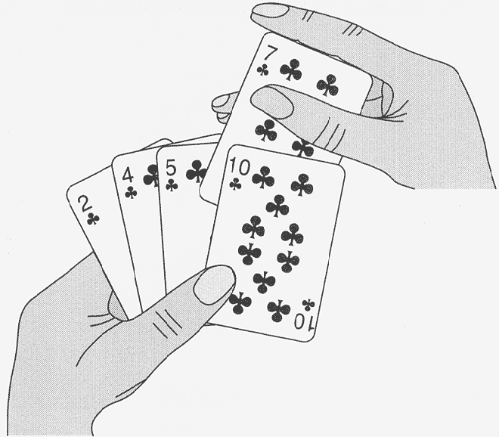
An Example of Insertion Sort

Slide 12
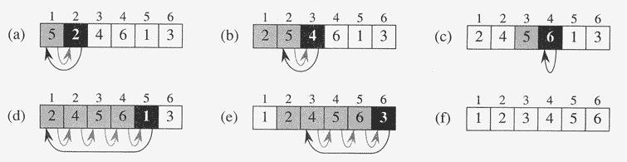
An Example: Insertion Sort
InsertionSort(A, n) {
for i = 2 to n {
key = A[i]
j = i - 1;
while (j > 0) and (A[j] > key) { A[j+1] = A[j]
j = j - 1
}
A[j+1] = key
}
}

Slide 13
An Example: Insertion Sort
InsertionSort(A, n) {
for i = 2 to n {
key = A[i]
j = i - 1;
while (j > 0) and (A[j] > key){ A[j+1] = A[j]
j = j - 1
}
A[j+1] = key
}
}
Cost Time
c₁
n
c₂
n - 1
c₃
n - 1
c₄
P
c₅
P – (n – 1)
c₆
P – (n – 1)
c₇
n - 1

Slide 14
Analyzing Insertion Sort
T(n) = c₁n + c₂(n-1) + c₃(n-1) + c₄P + c₅(P - (n-1)) + c₆(P - (n-1)) + c₇(n-1)
= c₈P + c₉n + c₁₀
What can P be?
Best case: the array is sorted (inner loop body never executed)
P = n - 1
T(n) = an + b, a linear function of n
Worst case: the array is reverse sorted (inner loop body executed for all previous elements)
P = 2 + 3 + 4 + ….. + n
P = (1 + 2 + 3 + 4 + ….. + n) – 1 = n(n + 1)/2 – 1
T(n) = an² + bn + c, a quadratic function of n
Average case:
???

Slide 15
Asymptotic Performance
We care most about asymptotic performance
How does the algorithm behave as the problem size gets very large?
Running time
Memory/storage requirements
Bandwidth/power requirements/logic gates/etc.

Slide 16
Asymptotic Analysis
Worst case
Provides an upper bound on running time
An absolute guarantee
Average case
Provides the expected running time
Very useful, but treat with care: what is “average”?
Random (equally likely) inputs
Real-life inputs
Best case

Slide 17
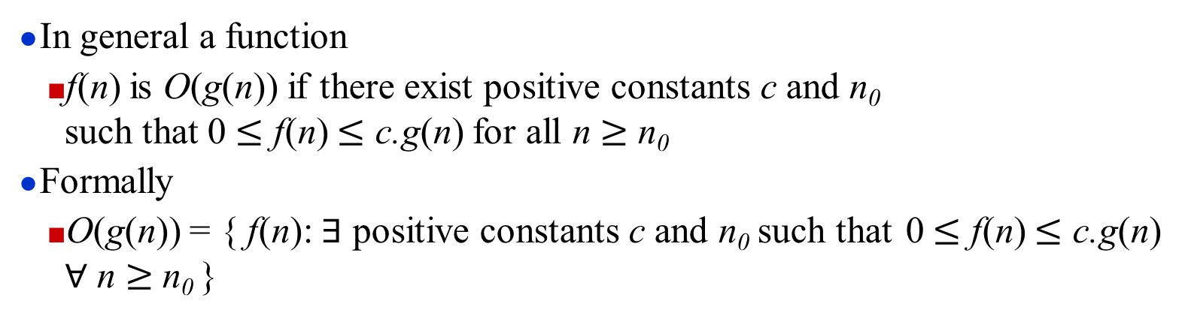
Upper Bound Notation
We say InsertionSort’s run time is O(n²)
Properly we should say run time is in O(n²)
O as “Big-O” (you’ll also hear it as “order”)
In general a function
f(n) is O(g(n)) if there exist positive constants c and n₀
such that 0 $≤$ f(n) $≤$ c.g(n) for all n $≥$ n₀
Formally
O(g(n)) = { f(n): $∃$ positive constants c and n₀ such that 0 $≤$ f(n) $≤$ c.g(n) $∀$ n $≥$ n₀ }

Slide 18
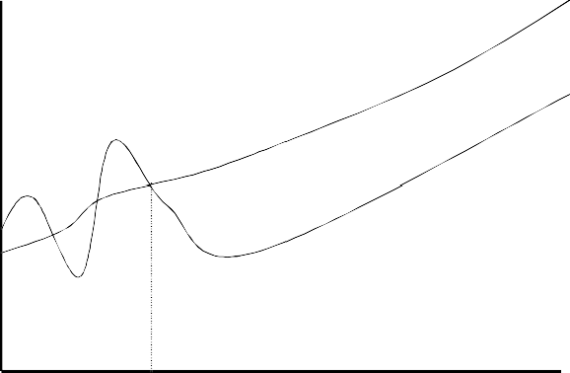
Upper Bound Notation
c.g(n)
f(n)
time
n₀ n
We say g(n) is an asymptotic upper bound for f(n)

Slide 19



Example
Prove that, Order of 10n² + 7n + 4 is n²
Here, f(n) = 10n² + 7n + 4
Here, g(n) = n²
Need to find a c and n₀ such that 0 $≤$ f(n) $≤$ c.g(n) for all n $≥$ n₀
Let, c = 15
21
15
0 $≤$ f(n) $≤$ c.g(n) Not satisfied
n = 1
f(n) =
c.g(n) =
58
60
0 $≤$ f(n) $≤$ c.g(n) Satisfied
n = 2
f(n) =
c.g(n) =
n = 3
f(n) =
115
c.g(n) =
135
0 $≤$ f(n) $≤$ c.g(n) Satisfied
If c = 15 then for all n $≥$ 2, 0 $≤$ f(n) $≤$ c.g(n) will be satisfied
So, O(10n² + 7n + 4) = O(n²)
Why c = 15?

Slide 20
Upper Bound Notation
c.g(n)
f(n)
time
n₀ n
We say g(n) is an asymptotic upper bound for f(n)

Slide 21
Example
Can we say, Order of 10n² + 4n is n³?
Here, f(n) = 10n² + 4n
Rewrite: f(n) = 0.n³ + 10n² + 4n
Here, g(n) = n³
Need to find a c and n₀ such that 0 $≤$ f(n) $≤$ c.g(n) for all n $≥$ n₀
Let, c = 1
14
1
0 $≤$ f(n) $≤$ c.g(n) Not satisfied
n = 1
f(n) =
c.g(n) =
n = 11
f(n) =
1254
c.g(n) =
1331
0 $≤$ f(n) $≤$ c.g(n) Satisfied
n = 12
f(n) =
1488
c.g(n) =
1728
0 $≤$ f(n) $≤$ c.g(n) Satisfied
If c = 1 then for all n $≥$ 11, 0 $≤$ f(n) $≤$ c.g(n) will be satisfied
So, O(10n² + 4n) = O(n³)

Slide 22
Practical Complexity
For large input sizes, constant terms are insignificant
Program A with running time T_{A}(n)= 100n
Program B with running time T_{B}(n)= 2n²
T_{B}(n) = 2n²
T_{P}(n)
T_{A}(n) = 100n

Slide 23
Thank you!
Any Questions?

